Slide 1
PA5658A ESD Failure Analysis
and Revision Plan
Oct. , 2018

Slide 2
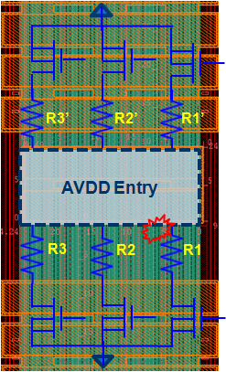
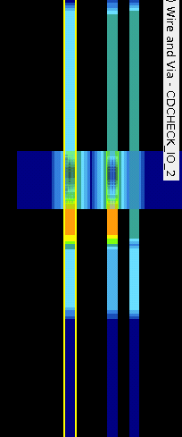
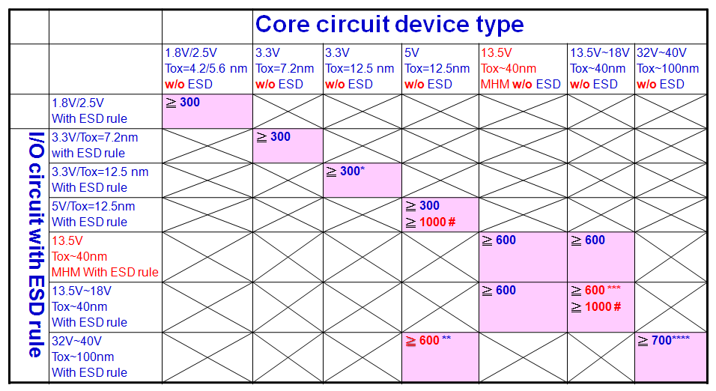
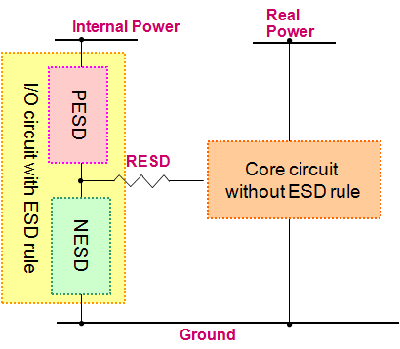
Outline
DDR3 ESD 6KV→8KV ECO Plan
  Revision is checked by CAD
  Revision will be verifyed by FIB
  Collected current silicon & FIB data as review SOP materials as in Fig. 1
GPIO Tolerant Structure 6KV → 8KV ECO Plan
  Revision is implemented by FIB and result could pass +/-8KV
  FIB 300 ohm & ECO is 500 ohm
  Include Perc Check to implement
  “current limit限流” R
  Fig. 2 is Perc Check
  circuit content
Fig. 1 R & Current Density Check
Poly R Width ≧ 3um
Fig. 2 RESD Check

Slide 3
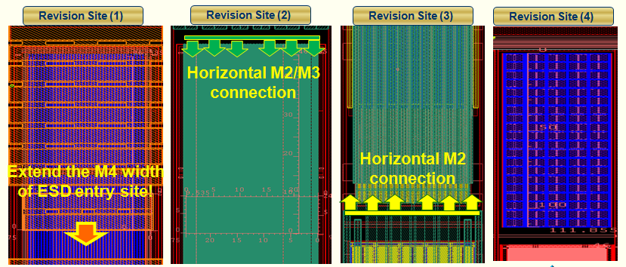
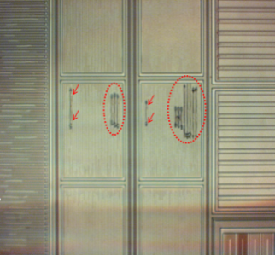
PA5658A DDR3 ESD ECO Plan Summary
PA5658A DDR3 ESD results: pass 6kV/300V LGD spec.
DDR3 DMPHY_1_PAD < 8kV analysis – power clamping cell
  Failure root cause:
    due to parasitic metal resistance that cause non-uniform turn on
    Insufficient pad pitch that cause high BEOL parasitic metal
  ECO plan: Reduce BEOL parasitic metal (反證法: Using FIB to prove far end
  NMOS is not helping ESD due to large metal resistance)
  ECO layers: M2/V2/M3/V3/M4
  Schedule: 待 RD/ SE 確認可執行, 即可進行修改
  Prevention plan: Will focus on BEOL resistance check by extracted R CAD tool
  after ESD cell design
M4 via沒直下不turn on
PAD
M4 & Via直下

Slide 4

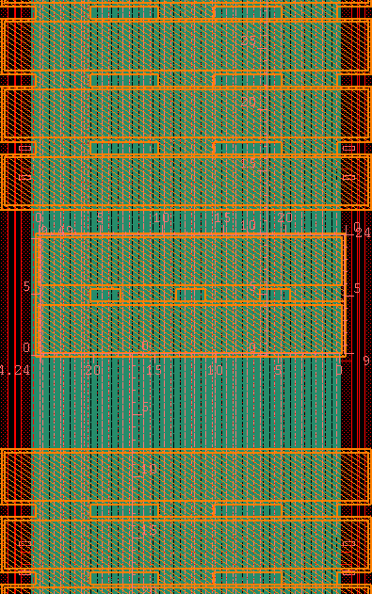


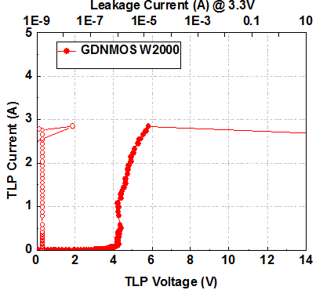
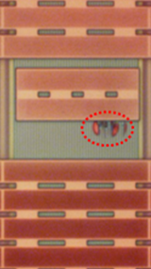
BEOL Resistance Check Flow
Root cause for DDR3 power clamp burn-out event
  BEOL routing would affect ESD discharging capability
  BEOL resistance evaluation
    From entry to upward routing : R1’ ≈ R2’ ≈ R3’
    R1’ &R2’ &R3’ consist of M1&M2&M3
    From entry to downward routing : R1 ≈ R2 ≈ R3
    R1 &R2 &R3 consist of M1&M2&M3&M4
Before Revision → R1 ≈ R2 ≈ R3 < R1’ ≈ R2’ ≈ R3’
After Revision → R1 ≈ R2 ≈ R3 ≈ R1’ ≈ R2’ ≈ R3’
R3’
R2’
R1’
AVDD Entry
R3
R2
R1
Down-ward
Up-ward
→ More balance △V after revision
Item | Before Revision | After Revision
R_{UP} | 4.297 | 1.191
△V @2kV | 5.72V | 1.58V
From PFA, the burnout
site found at downward
direction

Slide 5
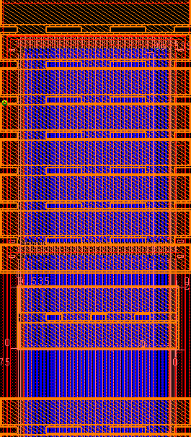
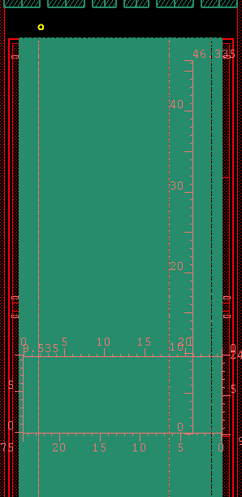
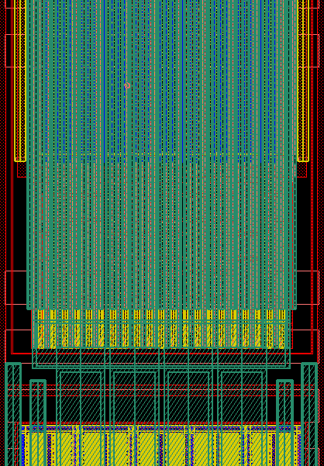
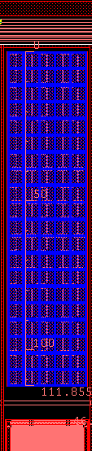

Solution for DDR3 IO ESD Enhancement
Enhanced solution for IP0866_02A_LPDDR3 CAPX_X_DR cell
  Reduce ESD energy per unit area at entry point
  Reduce parasitic impedance during clamp discharging
  Enhance current discharging capability at far-site finger
  Tradeoff between decap vs clamping device
Revision Site (1)
Revision Site (2)
Revision Site (3)
Revision Site (4)
Horizontal M2/M3 connection
Horizontal M2 connection
Extend the M4 width
of ESD entry site!

Slide 6
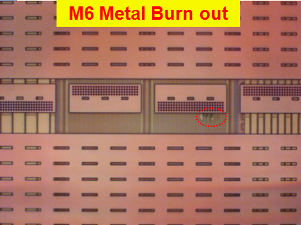
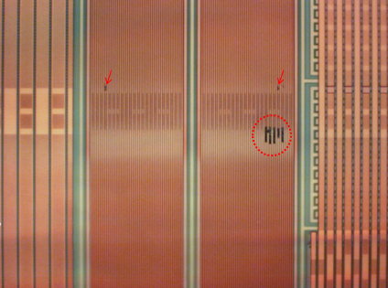
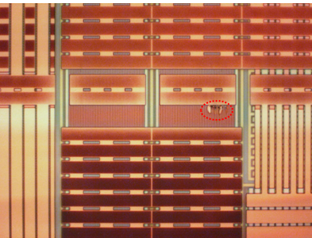
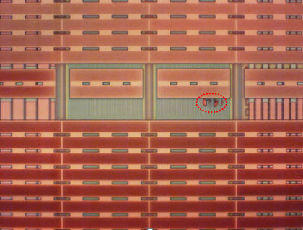

PFA Delayer with OM Analysis
M3 Metal Burn out
M4 Metal Burn out
M5 Metal Burn out
Sub Burn out

Slide 7
2. GPIO ESD ECO Plan Summary

Slide 8
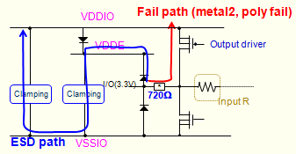
PA5658A GPIO ESD ECO Plan Summary
PA5658A ESD results: pass LGD spec.
HBM <8kV analysis - GPIO pin
  Fail root cause: high Ron on ESD path cause fail at 1st circuit
  ECO plan: add dummy R to prevent ESD current (已FIB 驗證 pass)
  ECO layers: M1/V1/M2
  Schedule: 待 RD/ SE 確認可執行, 即可進行修改
  Prevention plan: 此路徑為非預期的 parasitic 路徑, 加大R 可避免ESD current流入

Slide 9
PA5658A ESD Test Results
Item | LGD spec. | results | Fail level
HBM | 4kV | pass | Fail at 7kV (pass 6kV)
MM | 200V | pass | Fail at 350V (pass 300V)
CDM | 700V | pass | Fail at 1000V (pass 800V)
Latchup | - | > 300mA | -
IOESD | 6kV | pass | CSOT spec (10 zap): RX/GPIO: pass 8kV
Modify plan
HBM fail pin
GPIO pin:
LC2_U: 8kV fail
EIO1_D: 8kV fail
DeMura_SPI_SDO: 7kV fail

Slide 10
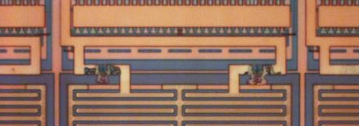
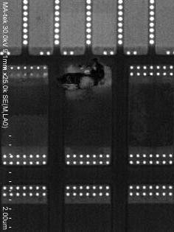
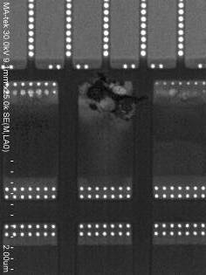
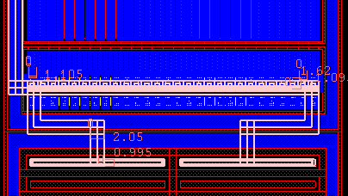
GPIO HBM <8kV Analysis
VDDIO
Fail path (metal2, poly fail)
VDDE
Output driver
Clamping
Clamping
I/O(3.3V)
R
720Ω
Input R
ESD path
VSSIO
U40 GPIO modify:
1. 請RD/ SE評估 R 是否可加大 (已留有dummy)
2. FIB add R experiment ➔ pass 8kV
3. ECO layers: M1/V1/M2
Poly w=1.1um
w=2um

Slide 11
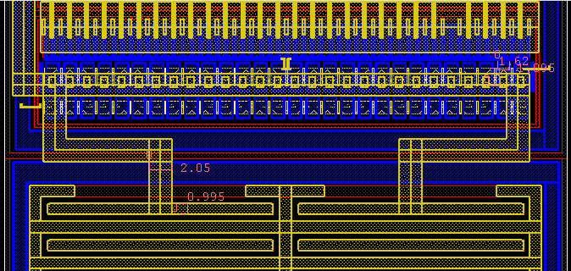
GPIO HBM Fail FIB Experiment
line3
line4
300ohm
300ohm
cut1
cut2
FIB: M2 cut 1 &2後, 連線line 3&4, 並加上300ohm 阻值
完成後打HBM 看是否有改善ESD level
➔FIB experiment pass +/-8kV
Current Limit R FIB is 300 ohm, ECO will be 500 ohm

Slide 12

Drive for better vision

Slide 13
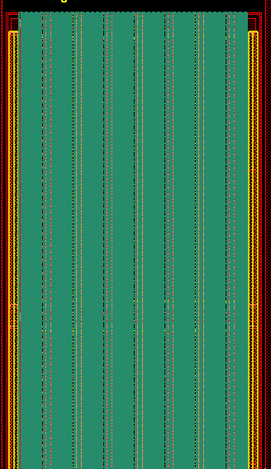

近端/遠端阻抗比較
DDR3遠近端電阻比較by calculation(1 finger width ~0.41um)
BEOL : M2& M3
Entry
Entry
46um
R_{BE,up}~0.74 Ohm
R_{BE,down}~2.06 Ohm
193um
Entry
BEOL : M2& M3

